Slide 1


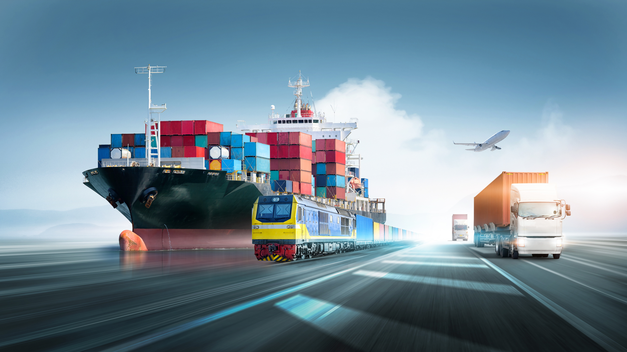

  WWW.KNSPLUS-LOGS.COM
We Build Trust
KNS PLUS LOGISTICS (THAILAND) CO., LTD.
WE BUILD TRUST DELIVERING INNOVATIVE
AND ADAPTIVE SUPPLY CHAIN SOLUTIONS WORLDWIDE.
SEA
AIR
LAND

Slide 2
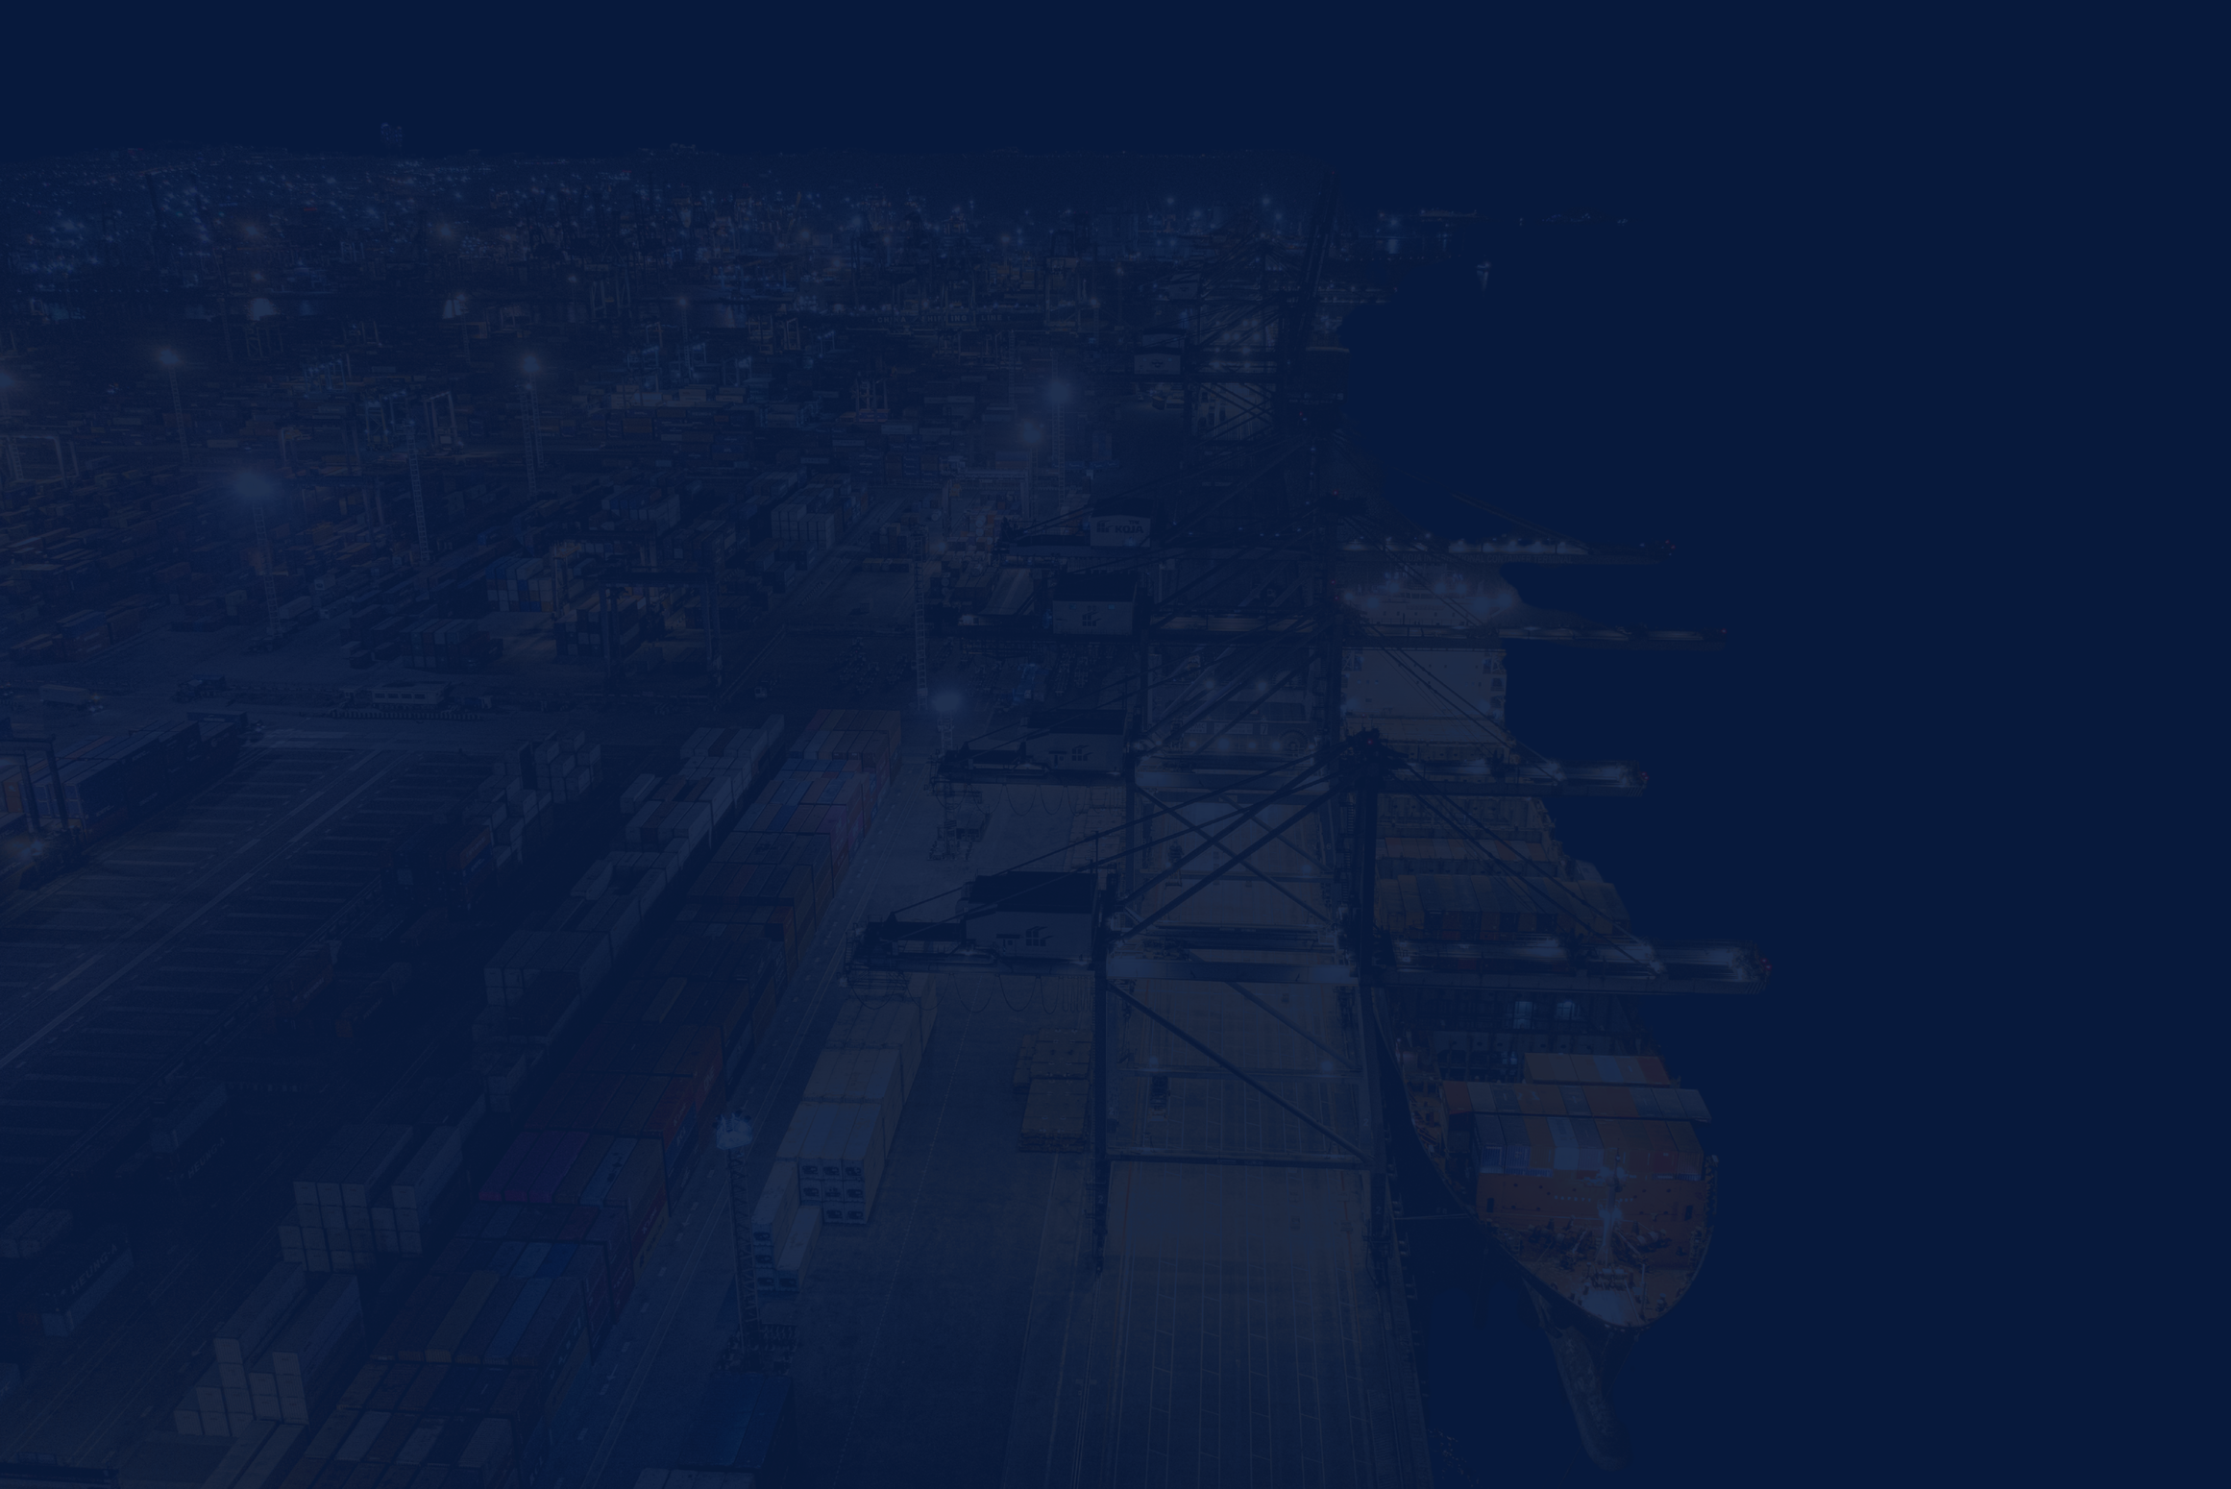

ABOUT KnS PLUS
  WWW.KNSPLUS-LOGS.COM
  KnS Plus Logistics is a Thailand-based logistics company established in 2026. We collaborate with KNS Taiwan and Wuxi Ruis International Logistics in China to provide comprehensive and reliable logistics solutions.
  KnS Plus specialize in International Freight Forwarding by Air, Sea and Land for Electronic, Machinery, Fashion & Lifestyle, Medical Equipment, Telecommunication equipment, and Oversize Projects.
  KnS Plus through our excellent global network of selected Agents to offer door to door import and export freight forwarding by Air, Sea and Land.
  KnS Plus has a well experienced team to handle and monitor all aspects of freight forwarding which includes transportation, project forwarding, consolidation, warehousing, export packing, customs clearance, procurement support and transportation of all types of oversized cargo.
We Build Trust
Efficient
Reliable
Transparent
Innovative

Slide 3
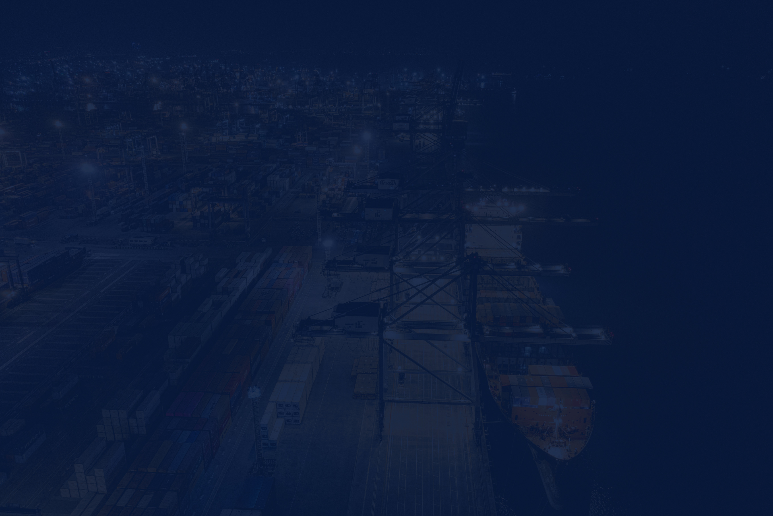
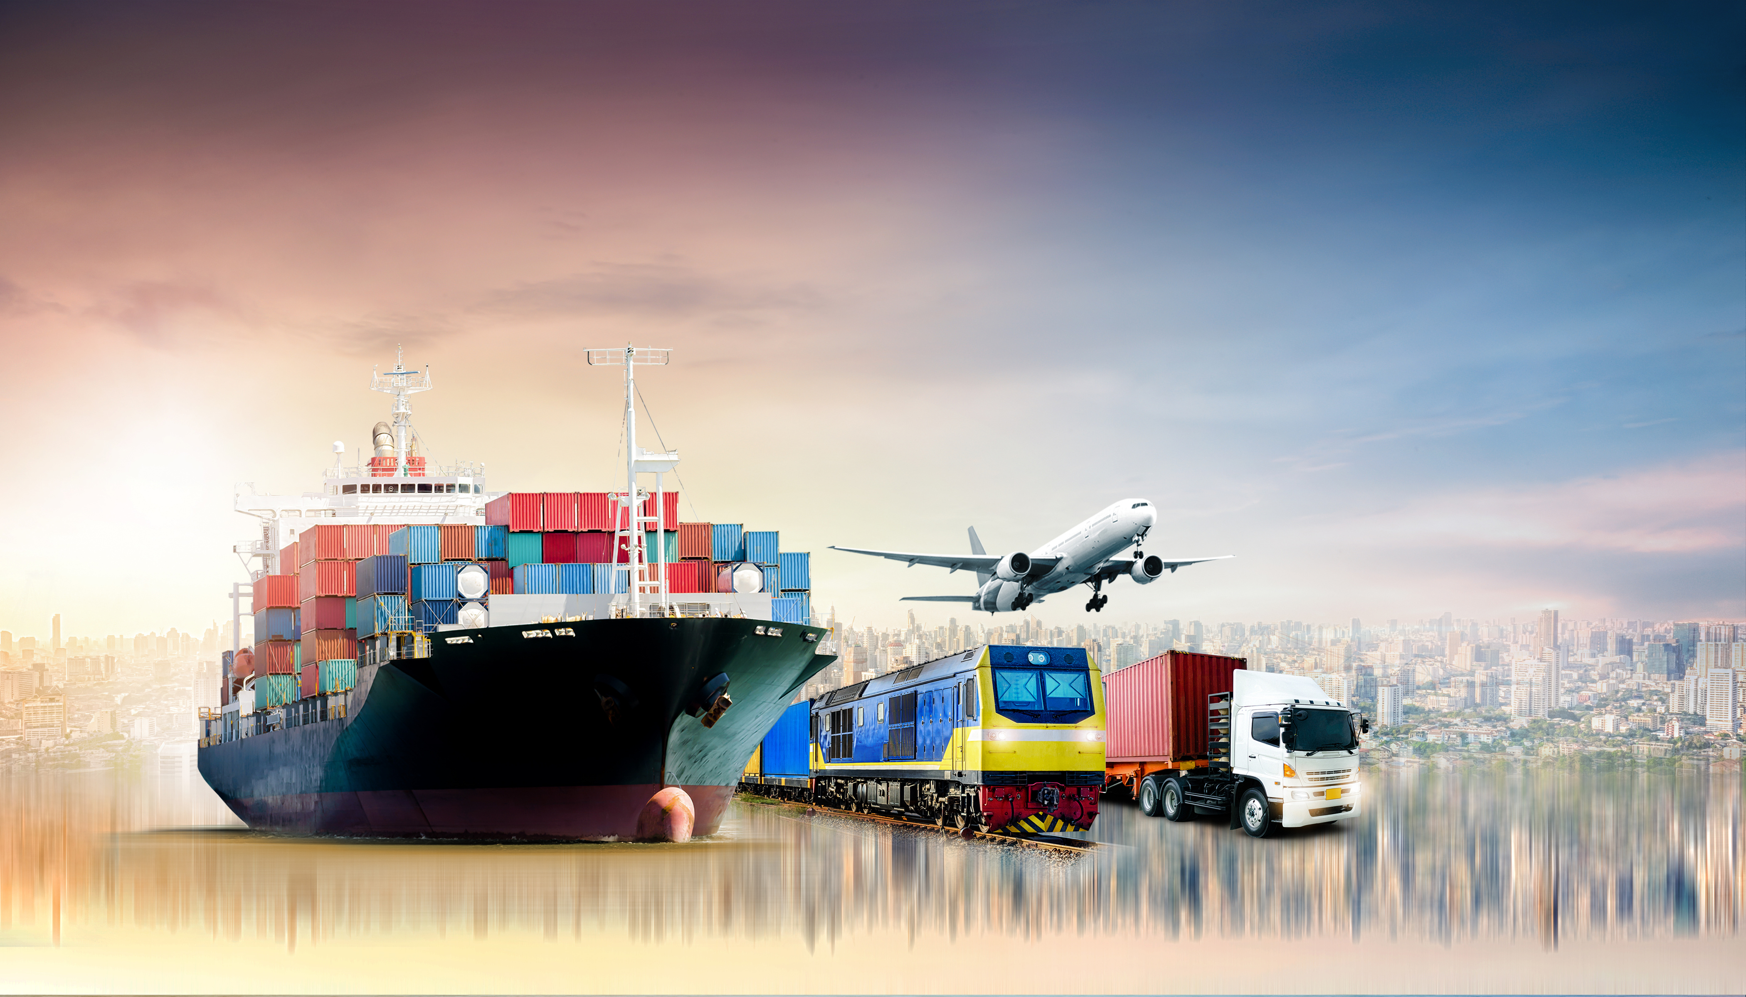

We Build Trust
WE BUILD TRUST
BEST PARTNER FOR YOUR WORLDWIDE LOGISTICS
OUR PURPOSE
VISION & MISSION
"To serve customers by designing, building,
and operating innovative logistics solutions."
We deploy robust frameworks designed specifically
to measurably improve delivery quality, reduce overall
system friction, and maximize client profitability.
MEASURABLE QUALITY
Constant KPI auditing and reporting.
ADAPTIVE ROUTING
Swift adjustment to changing geopolitical routes.
DIRECT EFFICIENCY
Removing middle agency cost markup.
WWW.KNSPLUS-LOGS.COM

Slide 4
We Build Trust
WHY
CHOOSE US ?
Flexible Delivery
Global Network
Real-time Tracking
Data-Driven &
Secured Handling
The delivery date or time can be adjusted based on the customer’s convenience and availability.
We having a reliable network
of partners and agents worldwide
to provide seamless logistics services.
Customers can monitor their shipment status and location in real time.
We using accurate data and secure processes to manage shipments efficiently, safely, and reliably.
WWW.KNSPLUS-LOGS.COM

Slide 5
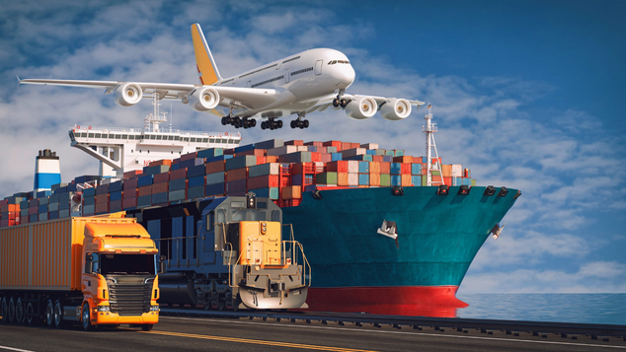
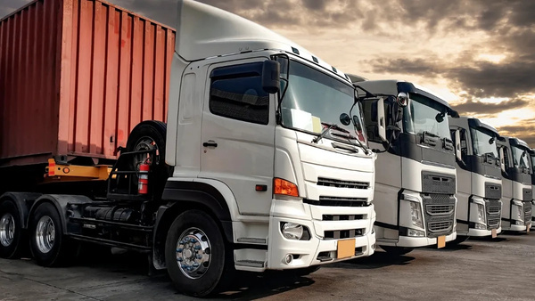
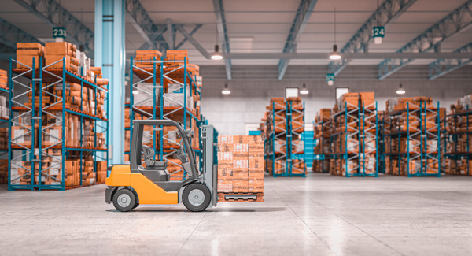
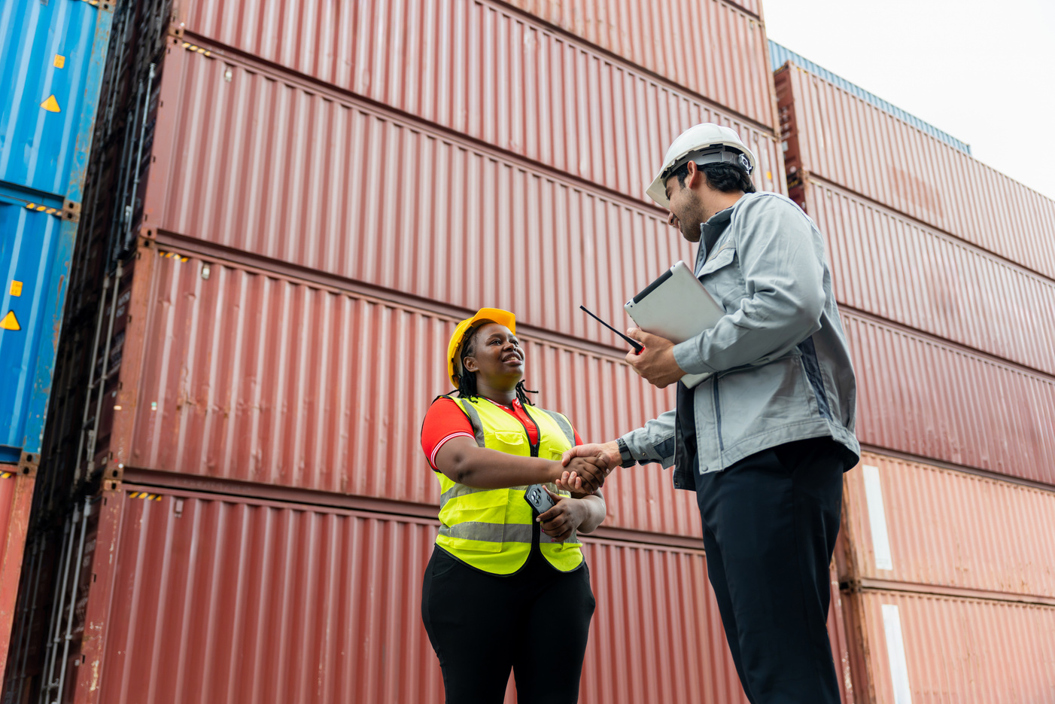
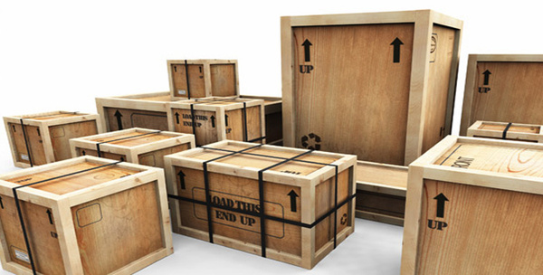
We Build Trust
SEAMLESSLY
SERVICES
FULL SERVICE FOR YOUR SHIPMENT
EXPORT-IMPORT CONSOLIDATOR
TRANSPORTATION
WAREHOUSING
CUSTOMS CLEARANCE
PACKING & LASHING
WWW.KNSPLUS-LOGS.COM

Slide 6
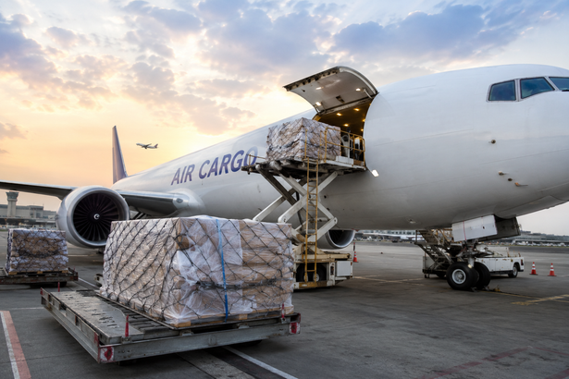
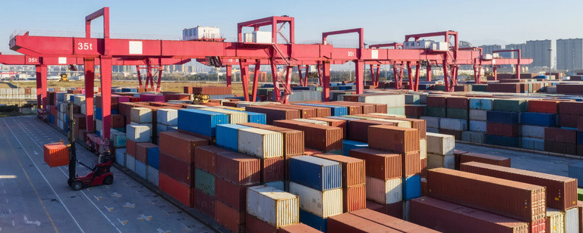
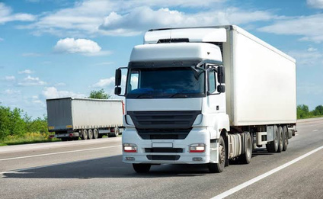
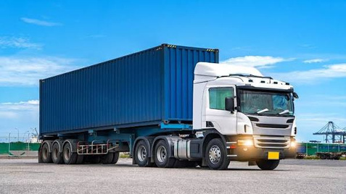
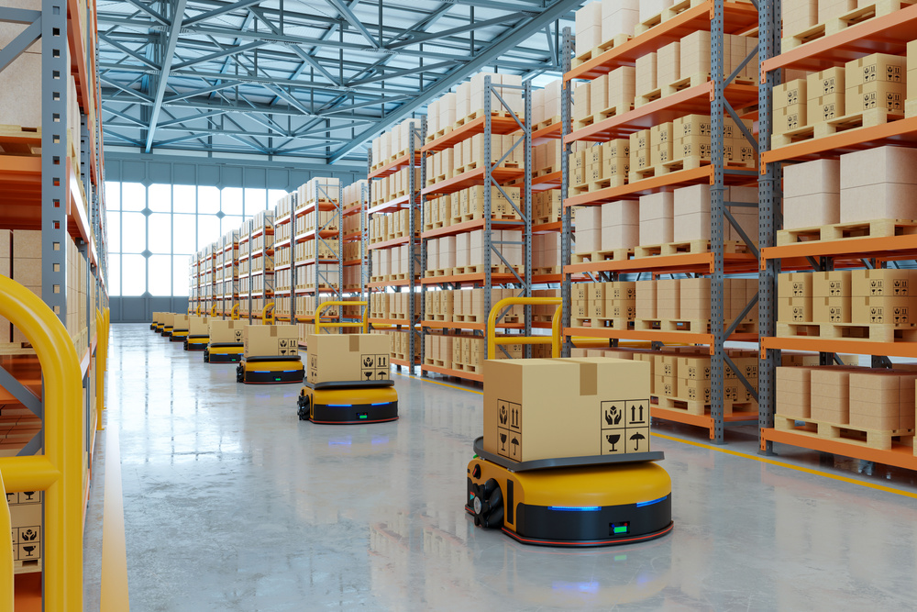
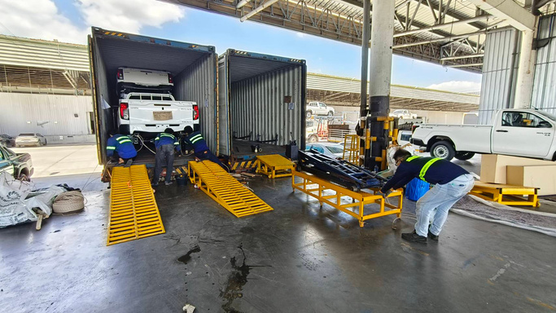
We Build Trust
AIR FREIGHT
SEA FREIGHT
Fast & Reliable Air Cargo Transportation of goods by air, ideal for urgent and time-sensitive shipments.
  Minimium - Tons.
Flexible and cost-effective ocean shipping solutions
  FCL
  LCL
  RORO
  Bulk
TRANSPORTATION
CROSS-BORDER
Fast domestic connecting manufacturers to regional shipping ports
  Trailer Truck
  Low Bed, Flat Bed
  10 Wheels
  6 Wheels
  4 Wheels
Seamless and reliable cargo movement across international borders.
  China
  Malaysia
  Cambodia
  Laos
  Myanmar
WAREHOUSE
PACKGING & LASHING
Secure and flexible storage solutions including General Freezone services for efficient inventory and cargo management.
  Lat Krabang
  Laem Chabang
Secure cargo packing and lashing to ensure safe handling and transportation.
  Packing
  Lashing Vehicles & Motorcycle
WWW.KNSPLUS-LOGS.COM

Slide 7
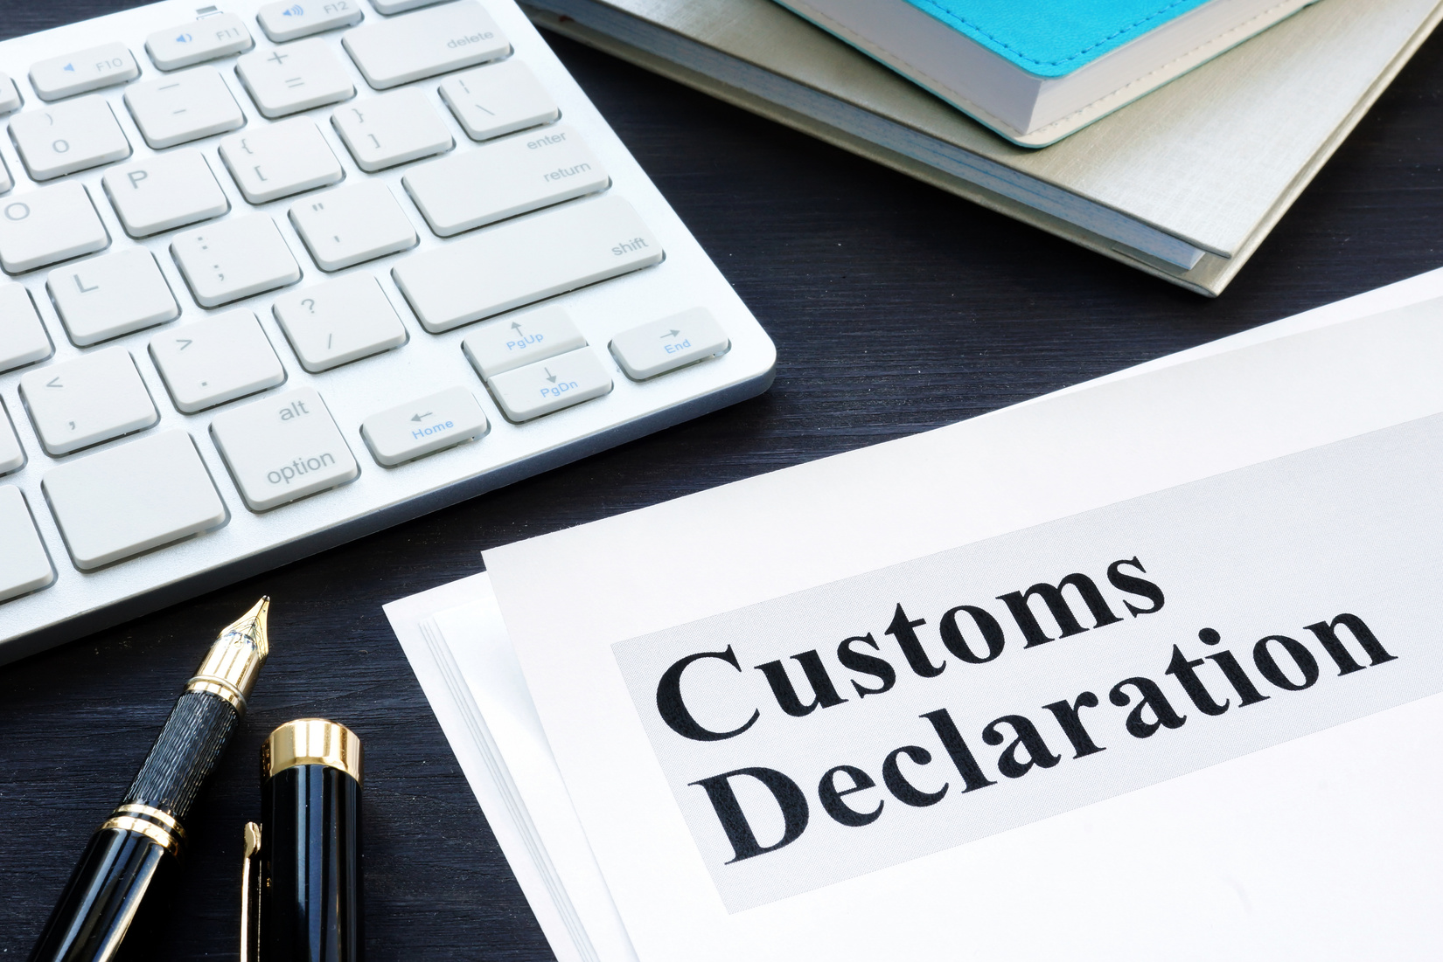
WWW.KNSPLUS-LOGS.COM
We Build Trust
CUSTOMS
BROKER
CUSTOMS CLEARANCE
CUSTOMS SPECIALIST
  Customs Declaration Prepare and submit import/export declarations.
  HS Code Classification Verify product classification and duty rates.
  Duty & Tax Management Calculate and check customs duties, VAT, and taxes.
  Tax Privilege Verification FTA, BOI, Free Zone, and duty exemptions.
  Import License & Compliance Check required permits and regulations.
  Customs Coordination Liaise with Customs authorities and handle inspections.
  Customs Consultation Advise on documentation, Incoterms, and import/export procedures.
  Post-Clearance Support Handle amendments, duty refunds, additional payments, and customs issues.

Slide 8
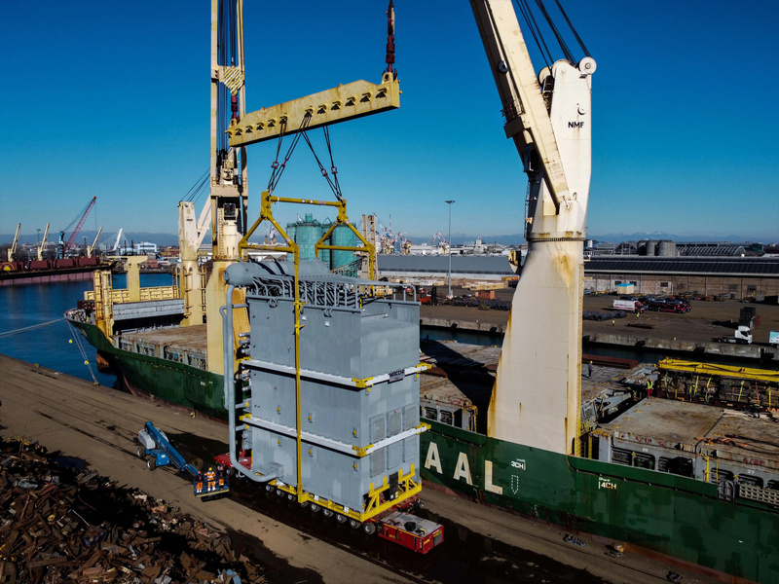
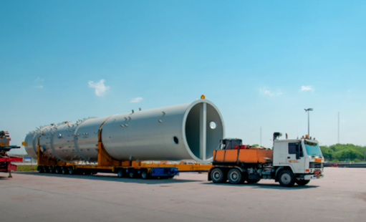
We Build Trust
EXHIBITIONS & OVERSIZED
01
Specialized logistics for exhibitions and oversized cargo, including transportation, handling, packing, and on-time delivery.
PROJECT
CARGO
OIL RIG & MINING EQUIPMENT
02
Specialized transportation for heavy, oversized oil rig and mining equipment, including heavy haulage, ocean freight, lifting, loading, and safe delivery to the project site.
VEHICLE TRANSPORTATION
03
End-to-end vehicle shipping solutions for transporting complete vehicles to Africa and the Caribbean, with safe handling, ocean freight, customs clearance, and reliable delivery.
WWW.KNSPLUS-LOGS.COM

Slide 9

We Build Trust
KnS PLUS LOGISTICS WORLDWIDE NETWORK
EUROPE
NORTH AMERICA
CARIBBEAN
ASIA
SOUTH AMERICA
AFRICA
AUSTRALIA
WWW.KNSPLUS-LOGS.COM

Slide 10















We Build Trust
KEY
CLIENTS
WWW.KNSPLUS-LOGS.COM

Slide 11
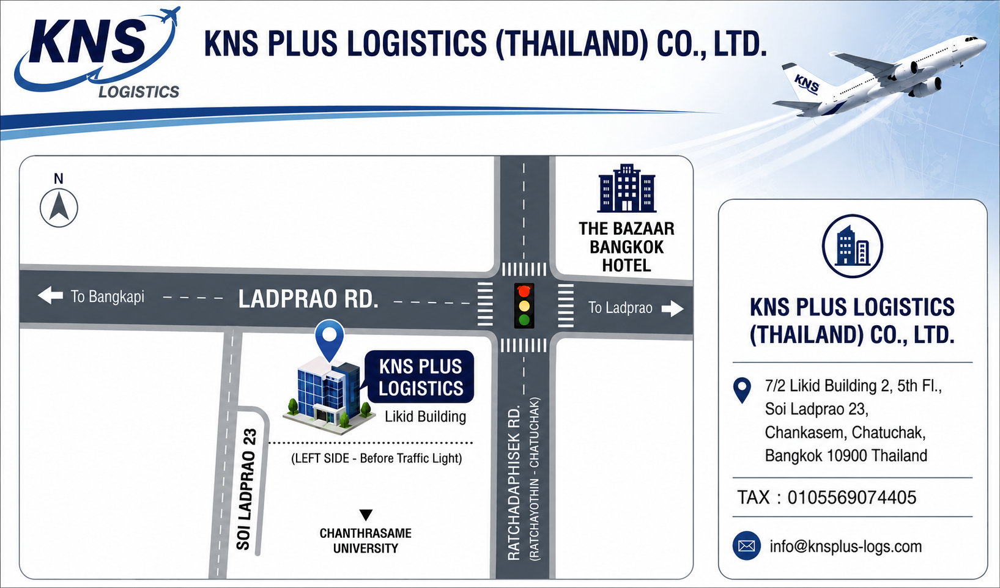

We Build Trust
+(66)2 0011668
CONTACT
WITH KnS PLUS
www.knsplus-logs.com
info@knsplus-logs.com
7/2 Likid Building 2, 5th Fl., Soi Ladphrao 23,
Chankasem, Chatuchak, Bangkok 10900 Thailand

Slide 12
THANK YOU
LET'S BUILD TRUST TOGETHER
We Build Trust

